Slide 1
IT1140 MINI PROJECT PROPOSAL
FreshGuard: IoT-Based Smart Fruit Bowl
Freshness monitoring and automatic ventilation for household fruit storage using embedded sensing and Wi-Fi data visualization.
PROJECT TEAM
TEAM LEADER
ACADEMIC SECTOR
SUBMISSION DATE
Group 13
KULATHUNGA M.A.S.S.
SLIIT Year 1, Sem 1
27 JULY 2026
TEAM MEMBERS
VINOJA H.W.O , SUBHASHANA T.O , PERERA M.K.J.C , SITHUMINI W.T.I , DAMAYANTHA H.A.E
SLIIT BSC (HONS) IN INFORMATION TECHNOLOGY • IT1140

Slide 2
The Household Fruit Storage Gap
Traditional fruit bowls are passive containers with no sensing, warning, storage, or environmental response.
Delayed Spoilage Awareness
Uncontrolled Micro-Environment
Household Waste Impact
Users usually notice spoilage only after visible colour change, unpleasant smell, softness, leakage, or mould appears. At that stage, quality loss has already occurred.
Temperature, humidity, and volatile gas accumulation can accelerate ripening and deterioration inside a poorly ventilated storage area.
Avoidable fruit spoilage causes direct economic loss and increases organic household waste when users cannot act early.
Core Problem Statement
Current household fruit bowls cannot monitor storage conditions, identify persistent freshness-related changes, preserve historical records, alert users early, or automatically improve ventilation.
FreshGuard Project Proposal • Group 13

Slide 3
Aim, Scope and Objectives
Focused project direction and measurable outcomes for the FreshGuard prototype.
AIM -
Design and implement an IoT-based smart fruit bowl that monitors storage conditions, records data, alerts users, and automatically activates ventilation.
SCOPE -
FreshGuard monitors fruit-storage conditions, provides early warnings, stores readings and automatically controls ventilation. It does not scientifically confirm whether fruit is safe to consume.
Objective 1
Acquire and test ESP32, DHT22, MQ-135, load cell, HX711, fan, indicators, and MicroSD hardware.
Objective 2
  Calibrate temperature, humidity, gas-baseline, and weight measurements under controlled conditions.
Objective 3
Implement sensor filtering, moving averages, persistence timers, and fault handling.
Objective 4
Develop Fresh, Attention, and Possible Spoilage Detected state logic with configurable thresholds.
Objective 5
Create a Wi-Fi web dashboard for live readings, status, fan control, and historical records.
Objective 6
Evaluate sensing, actuation, storage, IoT communication, and system recovery through repeatable tests.
FreshGuard Project Proposal • Group 13

Slide 4
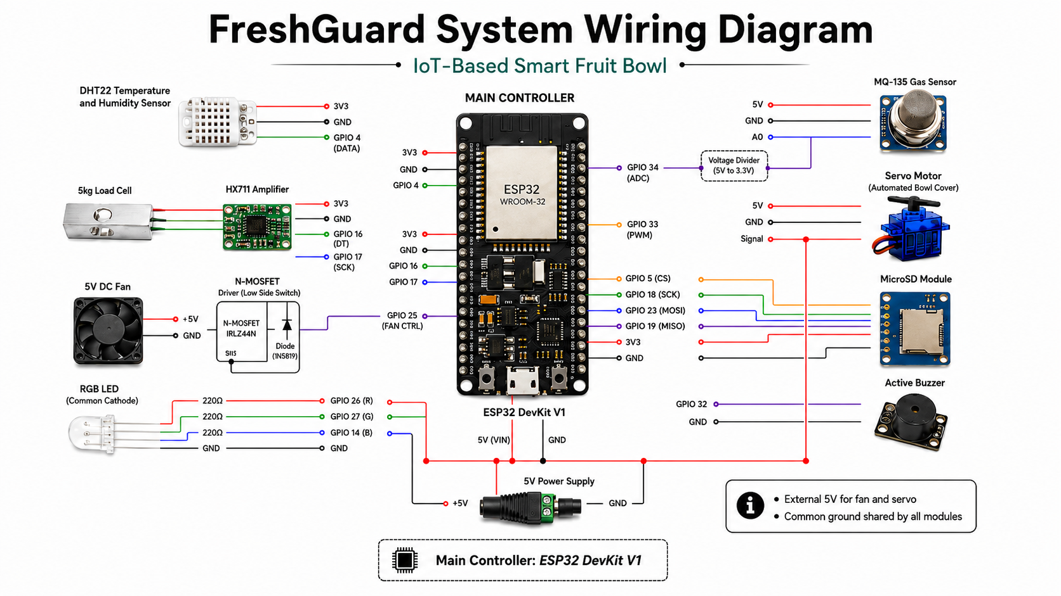
FreshGuard Project Proposal • Group 13

Slide 5
Sensors, Actuators, Memory and Main Components
Main hardware choices grouped by sensing, actuation, indicators, data memory, and IoT control.
Core Compute
Sensors
Actuators
ESP32 DevKit V1
Processes readings, logic, logging and Wi-Fi dashboard.
DHT22: temperature/humidity
MQ-135: gas/VOC trend
Load Cell + HX711: weight
5V DC fan for ventilation
SG90 servo for automated cover
MOSFET for safe switching
Local Alerts
Memory & IoT
Power & Prototype
RGB LED for status colour
Active buzzer for critical warning
MicroSD module saves history
Wi-Fi dashboard shows live readings and controls.
5V adapter, breadboard, jumper wires and locally fabricated bowl/base.
Estimated Electronics Total: Rs. 8000
Main modules, wiring and prototype power are included. 32GB MicroSD is optional.
FreshGuard Project Proposal • Group 13

Slide 6
System Architecture and Physical Prototype
How the sensing layer, ESP32 control unit, outputs, logging, dashboard and bowl layout fit together.
System architecture
Physical prototype layout
Upper fruit-storage section
DHT22
Fan
Temp + humidity
Ventilation
DHT22 and MQ-135 are placed near circulating air, away from juice and cleaning water.
MQ-135
ESP32 DevKit V1
Servo
Gas/VOC trend
Filtering • State Logic
Wi-Fi • Logging • Control
Cover
Load Cell + HX711
LED/Buzzer
Lower isolated electronics base
Weight changes
Warning
Inputs
Processing
Outputs
ESP32 • HX711 • MicroSD • MOSFET • Power remain separated from moisture and mechanical stress.
Data path
Sensor values are filtered, classified as Fresh / Attention / Possible Spoilage, logged to MicroSD and displayed on the web dashboard.
Safety summary
Food-safe separation • low-voltage DC operation • protected fan guard
FreshGuard Project Proposal • Group 13

Slide 7
Implementation Methodology and Operation
FreshGuard follows a simple cycle: Sense → Filter → Decide → Act → Log → Display.
PHASE 1
PHASE 2
PHASE 3
Sense
Filter
Decide
Reject invalid values and apply moving-average smoothing to suppress noise.
Classify condition as Fresh, Attention or Possible Spoilage using sustained readings.
Read temperature, humidity, gas/VOC, and weight data at scheduled intervals.
PHASE 4
PHASE 5
PHASE 6
Execute
Update web dashboard with live values, state label and control response.
Log
Display
Control the fan, automated cover, RGB LED, and buzzer according to the detected state.
Save readings, state changes, fan/servo activity and alerts to MicroSD.
FreshGuard Project Proposal • Group 13

Slide 8
Budget, Project Plan and Expected Results
A compact delivery plan showing cost control, build milestones, and final demo evidence.
Estimated Cost
Expected Result
Evaluation Method
Rs. 8000 for main electronics and prototype power.
Prototype senses, decides, responds, logs and displays data.
Test sensor accuracy, actuator response, MicroSD logging, dashboard updates, and system recovery.
Period
Primary Focus & Goals
Milestone Deliverable
Team Participation
Weeks 1–3
Research, problem analysis, proposal document, and presentation preparation.
Approved proposal package
All members
Weeks 4–6
Hardware sourcing, breadboard testing, sensor calibration, and circuit validation.
Functional sensor modules
Hardware + software teams
Weeks 7–8
ESP32 firmware, MicroSD logging, dashboard endpoints, and state logic.
Progress presentation
Software + IoT team
Weeks 9–10
Enclosure construction, load-cell mounting, airflow path, and full integration.
Completed physical prototype
Entire group
Weeks 11–12
Controlled evaluation, tuning, documentation, and final live demonstration.
Final assessment demo
All members
FreshGuard Project Proposal • Group 13

Slide 9
Questions & Discussion
FreshGuard introduces entry-level automated food care through sensing, local actuation, data storage, and web monitoring.
Group 13 • SLIIT Year 1, Semester 1 • IT1140 – Fundamentals of Computing
KULATHUNGA M.A.S.S. • VINOJA H.W.O. • SUBHASHANA T.O.• PERERA M.K.J.C. • SITHUMINI W.T.I. • DAMAYANTHA H.A.E.
SLIIT BSC (HONS) IN INFORMATION TECHNOLOGY • IT1140

